Slide 1

ML 101 Course
Arush Garg
AI and Machine Learning Club
Overseas Family School

Slide 2
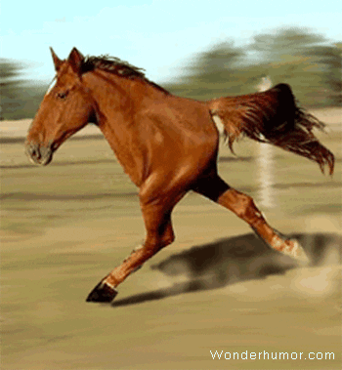

Course (bit.ly/ML_101)
Introduction to Machine Learning (ML)
Regression
Core ML Concepts
Classification
Decision Trees
Model selection and tuning
Unstructured data: Text
Neural Networks
Unstructured data: Images
Introduction to Deep Learning
Beyond Regression & Classification
Notes:
Welcome back to ML 101 course. Today we will learn how to train an Image Classification model, and learn about a new architecture.

Slide 3
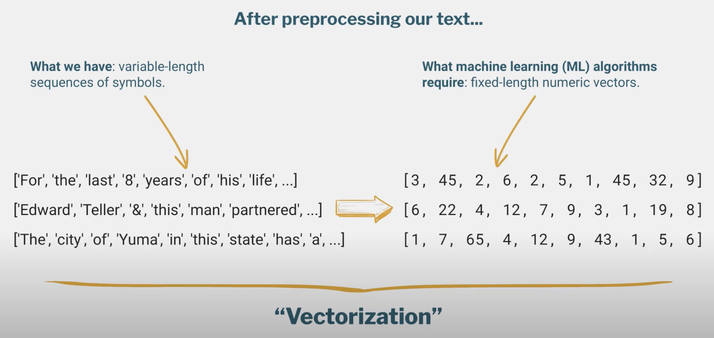
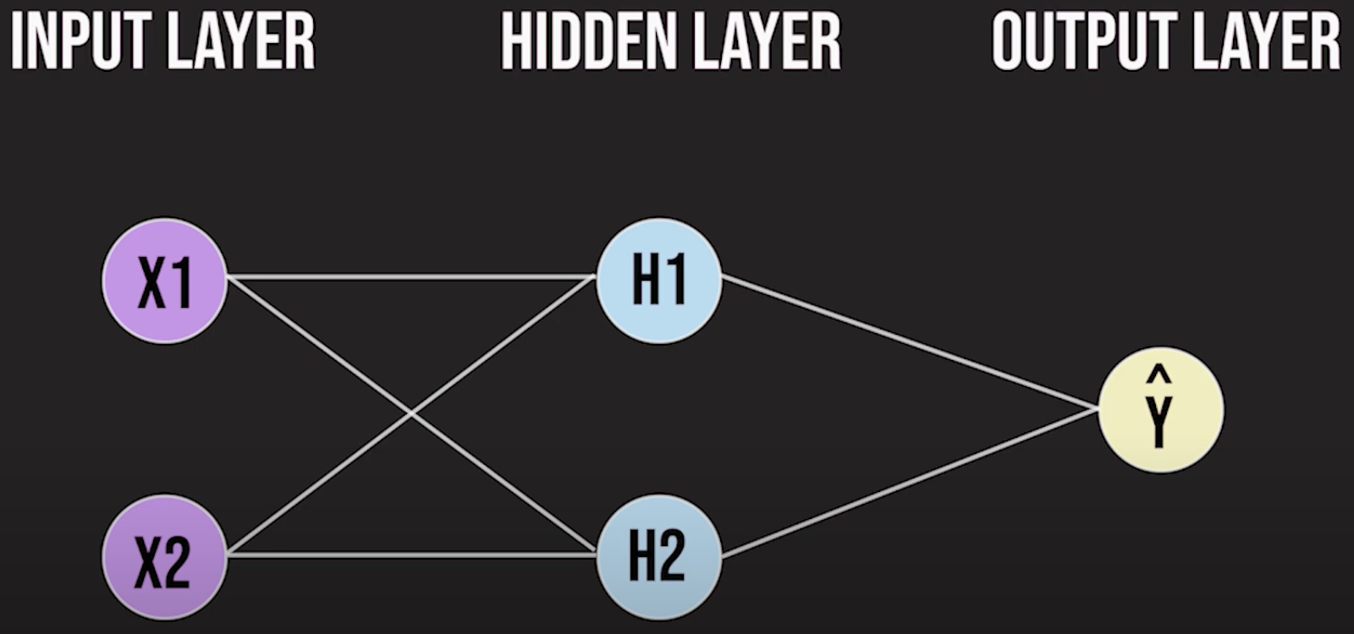
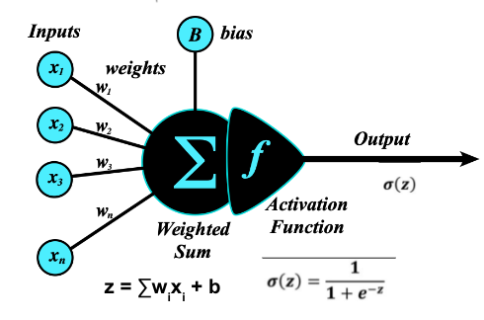
Recap
Handling unstructured data: Text Classification
Data Cleaning
Tokenization: ngrams
Bag of Words (BOW) : Vectorizes “variable length sequence of tokens” to “fixed-length numeric feature vectors”
Neural Networks
Network of “neurons” organized in layers
Each neuron is a simple learner like LogisticRegression and performs two tasks: compute Weighted Sum and apply Activation Function. Output is between 0 and 1.
Forward Propagation (input layer => hidden layer => output)
Information flow that makes the prediction
Backward Propagation (reverse direction)
Used for updating the weights to improve model performance during training process
Softmax: activation function used for multi-class classification
ANN = fully-connected neural network
Notes:
In earlier lesson we learnt how to do “text classification”. We first convert text to a “collection of tokens” that includes the terms and phrases in the text. And then we used Bag of Words vectorization technique to convert these “variable length sequence of tokens” to “fixed length numeric feature vectors” that can be fed to an ML algorithm.
In the last lesson we introduced Neural Networks which is a network of neurons that are organized in layers. Each neuron is a simple ML model in itself, very similar to LogisticRegression. To make a prediction, information flows from input layer to hidden layer, finally reaching the output layer that makes the prediction.
As part of training process, the information also flows in the reverse direction in order to update the weights between all layers.

Slide 4



ML Libraries: Sklearn / TensorFlow / Keras
So far we have used sklearn (scikit-learn) python library for ML model training.
More popular library for Neural Networks, esp. Deep Learning, is TensorFlow.
Keras is a high-level neural networks API that runs on top of TensorFlow, designed for simplicity and ease of use, allowing for quick prototyping and experimentation in deep learning.
We will be using Keras in this lecture’s hands-on exercise
Notes:
So far we have been using scikit-learn which is the most popular python library for Traditional ML algorithms.
Now that we are getting deeper into Neural Networks, TensorFlow is better suited for this task.
TensorFlow is quite complex and would take a while to learn, but Keras, another python library built on top of TensorFlow, makes it super easy.
We will be using Keras for today’s Image Classification task

Slide 5
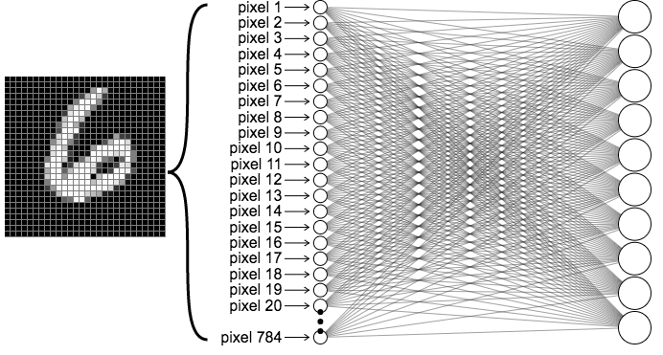
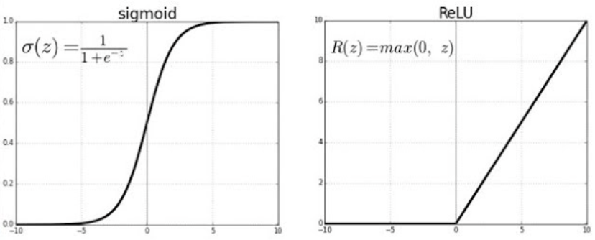
Using ANNs for Image Classification
Image pixel values are fed as input features
28x28 image = 784 input features in (0, 255) range
Hands-on exercise - Hidden layers: (50, 25)
Activation function in hidden layer can be Relu or Sigmoid. This is another model hyperparameter.
# of parameters in this ANN
Layer 1: 784*50 + 50 = 39,250
Layer 2: 50*25 + 25 = 1,275
Output: 25*10 + 10 = 260
Total = 40,785
Output layer size = 10 (one neuron for each class).
Softmax activation function converts weighted sum to relative probability.
Notes:
A problem to recognise handwritten digits, posed by the MNIST dataset, can be solved using an Artificial Neural Network, the fully connected one we learnt about last time.
The image can be flattened to 784 pixels, which will be used as input features. Since the image is greyscale, each value will be between 0 and 255.
(click)
In the hands-on exercise, I added two hidden layers, one with 50 nodes and the other with 25. These hidden layers can have either the sigmoid or relu activation function, which is another model hyperparameter.
And finally, we have the output layer with 10 neurons, with a softmax function to give the final probabilities.
In the first layer has 784 times 50 weights, along with 50 biases, 1 per neuron. Hence, the total parameters to learn in the first hidden layer is more than 39 thousand.
The second hidden layer is much smaller, with 50 weights for each of the 25 neurons, along with 25 total biases. This adds another 1275 parameters.
Finally, the output layer has 10 neurons, each of which has 25 weights and 1 bias, a total of 260 parameters for this layer.
In all, the training process involves learning more than 40 thousand parameters, using forward and backward propagation.

Slide 6
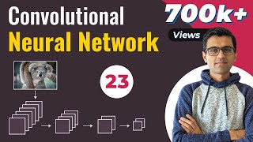
Convolution Neural Networks (CNNs): Convolution Layer
codebasics
Notes:
Now, let’s look at another architecture that is much better suited for image-related problems.
(click to play video)

Slide 7
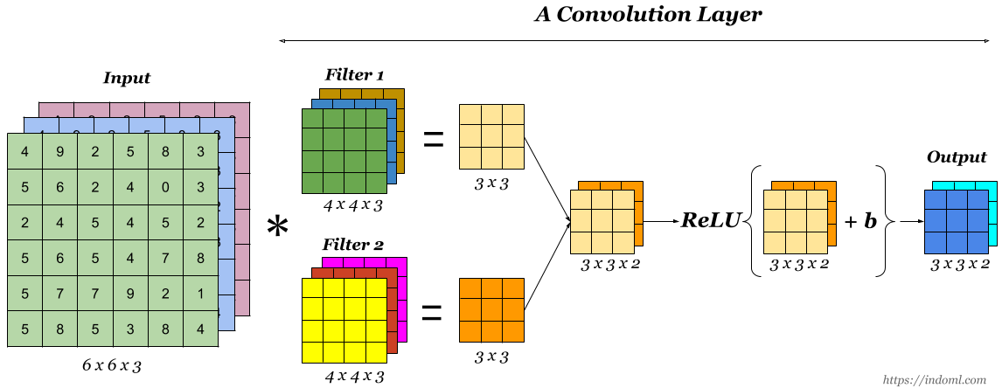
Important points
ANN has limitations for Image Classification task: too many parameters & doesn’t leverage spatial proximity info
Convolution layer: uses a “collection of filters” to detect patterns in the image. Uses activation function like Relu to introduce non-linearity
CNN: initial convolution layers recognize simple features like edges & loops and as information passes through more layers, the subsequent convolution layers assembles these features to learn more complex features
Explaining the image above
Input image = 6x6x3. “3” here refers to (R, G, B) as it’s a colored image
Using two 3D filters of size 4x4x3 we get two 3x3 outputs. When layered on top of each other, it results in 3x3x2 final output
Now this 3D output (3x3x2) can be an input to next convolution layer
# of parameters do not depend on the size of the input image. It depends on “size & number of filters”. And the number of convolution layers.
It also depends on pooling layer, as we will see in the next video.
The output of the last convolution layer is flattened and used as input to a fully-connected layer (just like we do in ANN)
Notes:
As we saw, ANNs are not best suited for handling large image inputs.
A convolution layer scans over input data using learnable 2D or 3D filters to detect and capture spatial patterns in the image.
In a typical CNN architecture there are multiple convolution layers. Initial convolution layers recognize simple features like edges & loops and as information passes through more layers, the subsequent convolution layers assembles these features to learn more complex features
This solves for the two important ANN limitations when it comes to processing images. One, it leverages the spatial information in the image. Second, the number of model parameters do not depend on the size of the input image. It depends on the size and number of filters, the number of convolution layers in the overall model architecture and how we use the pooling layers, something we will learn in the next video.

Slide 8
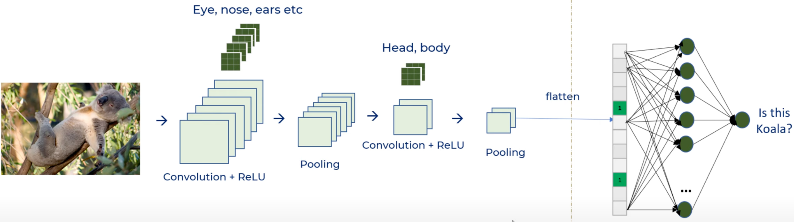
Pooling layer
Every convolution layer output is like a 3D image
Pooling followed by Convolution layer helps reduce the output size and hence the # of parameters
Pooling operation doesn’t require any training or learning. It simply picks “max” (most popular) or “avg” value as output.
A 2x2 pooling with stride of 2 makes the output one-fourth
codebasics
Notes:
Often in CNN architecture, a convolution layer is followed by a “pooling layer” before the output is fed to the next convolution or fully connected layer.
Let’s learn about the ‘pooling layer” in this video
(click)

Slide 9

Hands-on Exercises
Lesson 9 / Fashion_Classification.ipynb
https://bit.ly/ML_101
Notes:
The problem for this lesson’s hands-on exercise is to identify the piece of clothing in a 28 x 28 image, from the Fashion MNIST dataset.
We will try this problem with both architectures, ANNs and CNNs.
The repo has also been linked in the description below

Slide 10
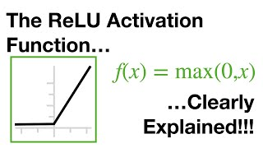

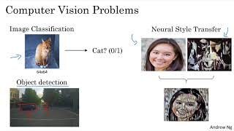
Further Reading / Watching / Doing
MNIST_Classification.ipynb
https://bit.ly/ML_101
Relu
Computer Vision Course from DeepLearningAI
Notes:
Try using CNNs for another very similar problem: The original MNIST dataset. This dataset has 60,000 handwritten digits from 0-9, a multi-class classification problem. There are more details in this lesson’s problem.md file.
To learn more about the Relu activation function and other aspects of computer vision, check out these videos.

Slide 11
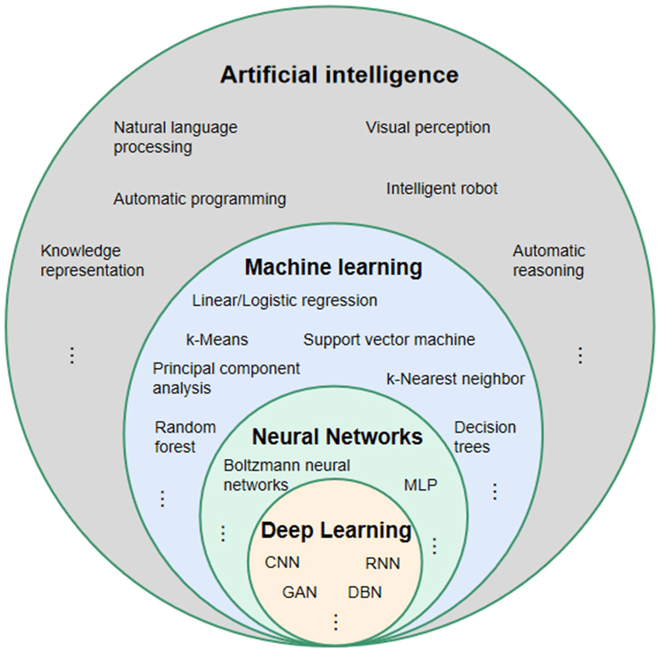
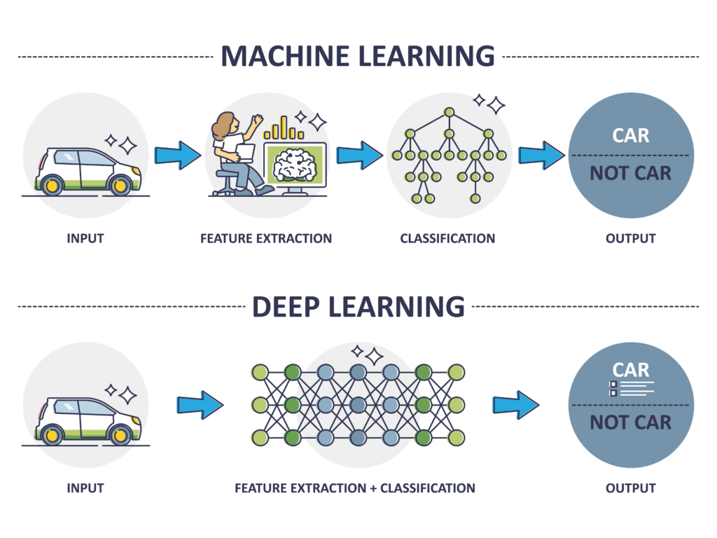
Agenda for next class
Introduction to Deep Learning
What is Deep Learning?
What are Embeddings?
Deep Learning architectures beyond CNNs
RNNs (Recurrent Neural Networks)
Introduction to Language Models, Text Generation
Large Language Models
Notes:
CNNs we learnt about in this session are a type of Deep Learning model architecture. In the next lesson we will explore Deep Learning in more detail.
We will talk about embeddings, recurrent neural networks and language models.

